Slide 1
RSM222
Management Accounting 1
Class 4: In Class Exercise
Elisa Zuliani

Slide 2
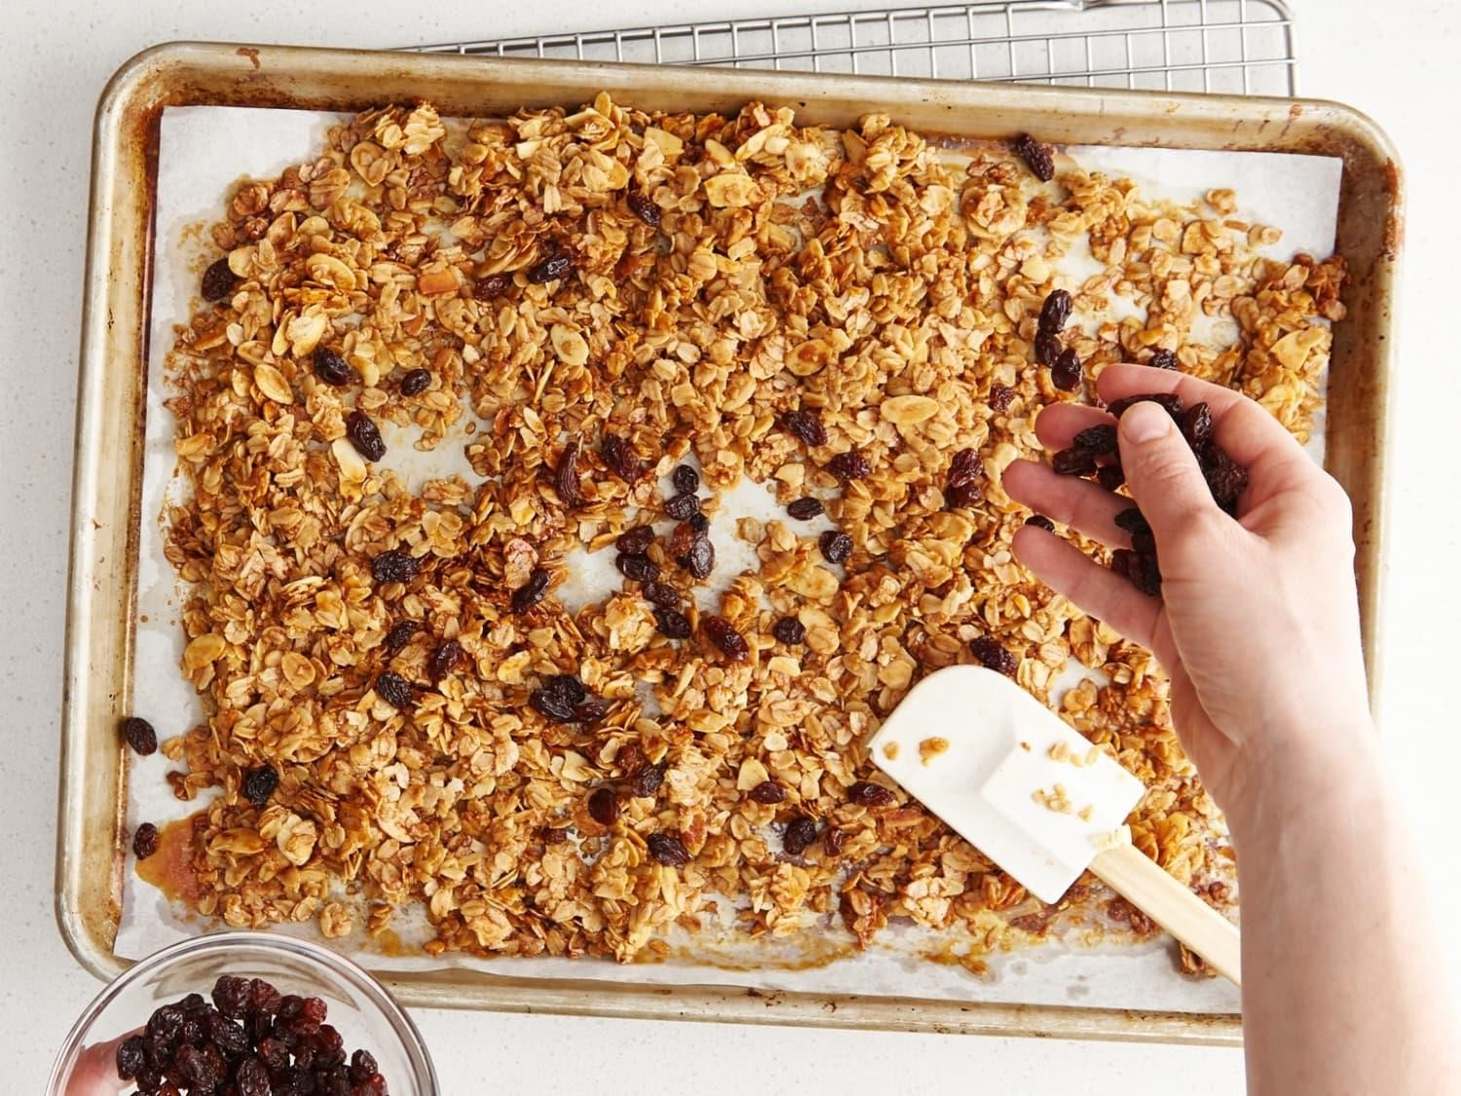
IN CLASS EXAMPLE
Orchard Granola

Slide 3

Orchard Granola Inc
Orchard Granola Inc. (OGI) produces granola bars that are packaged individually and sold to various grocery stores. OGI has 2 departments that consist of the mixing/baking department and the packaging department.
Dept A: Mixing/Baking
Dept B: Packaging

Slide 4
Orchard Granola Inc.
Mixing/Baking Dept. | Units | % Complete Materials | Costs of Materials | % Complete Conversion | Cost of Conversion
WIP –Jan 1 | 1200 Bars | 15% | $150 | 20% | $250
Units Started in Production | 22,000 Bars |  | $19,150 |  | $13,700
Units transferred to Packaging Dept. | 22,400
WIP – March 30 | 800 | 35% |  | 45%
Compute the equivalent units for the Mixing/Baking Department.
What is the Cost per Equivalent Unit?
What cost should be assigned to the units transferred to the Packaging Department and the
units that remain in the WIP – Mixing/Baking Dept?

Slide 5
Orchard Granola Inc
1. Compute the equivalent units for the Mixing/Baking Department
Equivalent units = Number of partially completed units x percentage completion
Equivalent units of production = Units transferred to the next + Equivalent units
in ending department or finished goods work in process inventory
Material
= 22,400 + 800 * 35%
= 22,400 + 280
= 22,680
Conversion
= 22,400 + 800 * 45%
= 22,400 + 360
= 22,760

Slide 6
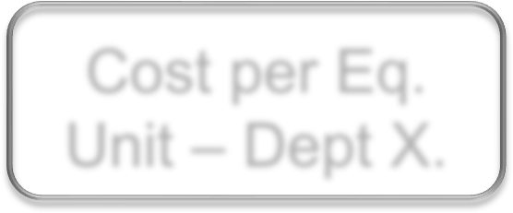

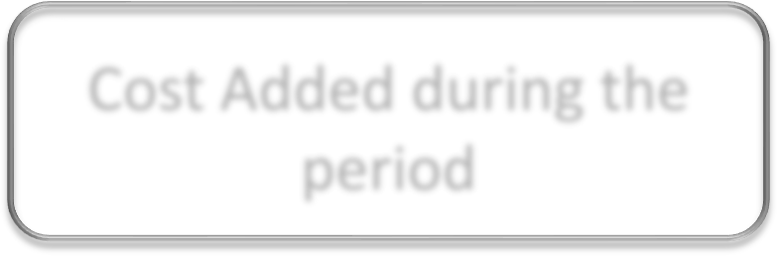

Orchard Granola
2. What is the Cost per Equivalent Unit?
Cost per Eq. Unit – Dept X.
Cost of Beg. WIP inventory
+
Cost Added during the period
=
Equivalent Units of Production
Material
= ($150 +$19,150)/22,680
= $19,300/22,680
= $.8510
Conversion
= ($250 +$13,7000)/22,760
= $13,950/22,760
= $.6129
Total
= $.8510+$.6129
= $1.4639

Slide 7
Orchard Granola
3. What cost should be assigned?
Cost of Units Transferred = # of Units Transferred * Cost per equivalent unit
Ending Inventory:
Equivalent units in WIP Ending Inventory * Cost per
equivalent unit
Material
Conversion
Total
1. Cost of Units Transferred
= 22,400 * $.8510
= $19,062.40
1. Cost of Units Transferred
= 22,400 * $.6129
= $13,728.96
1. Cost of Units Transferred
= 19,062.40 + 13,728.96
= $32,791.36
2. Ending Inventory
= 800*35% * $.8510
= 280 * $.8510
= $238.28
2. Ending Inventory
= 800*45% * $.6129
= 360 * $.6129
= $220.64
2. Ending Inventory
= 238.28+220.64
= $458.92

Slide 8
Weighted-Average Example
Step 5: Reconcile the Costs
Notes:
Computing the costs accounted for: The first step is to record the previously computed cost of ending working process inventory ($19,475). The second step is to record the previously computed cost of units transferred out ($715,200). The third step is to sum these two costs ($734,675). Notice the two totals agree indicating that all costs have been accounted for.

Slide 9
Any Questions?

